Slide 1

STROKE PREDICTION

Slide 2
PARAMETERS
ID
Gender
Age
Hypertension
Heart Disease
Ever Married
Work Type
Residence Type
Average Glucose Level
BMI
Smoking_Status
Stroke
TARGET VARIABLE

Slide 3

Exploratory Data Analysis TO GATHER DATA INSIGHT

Slide 4
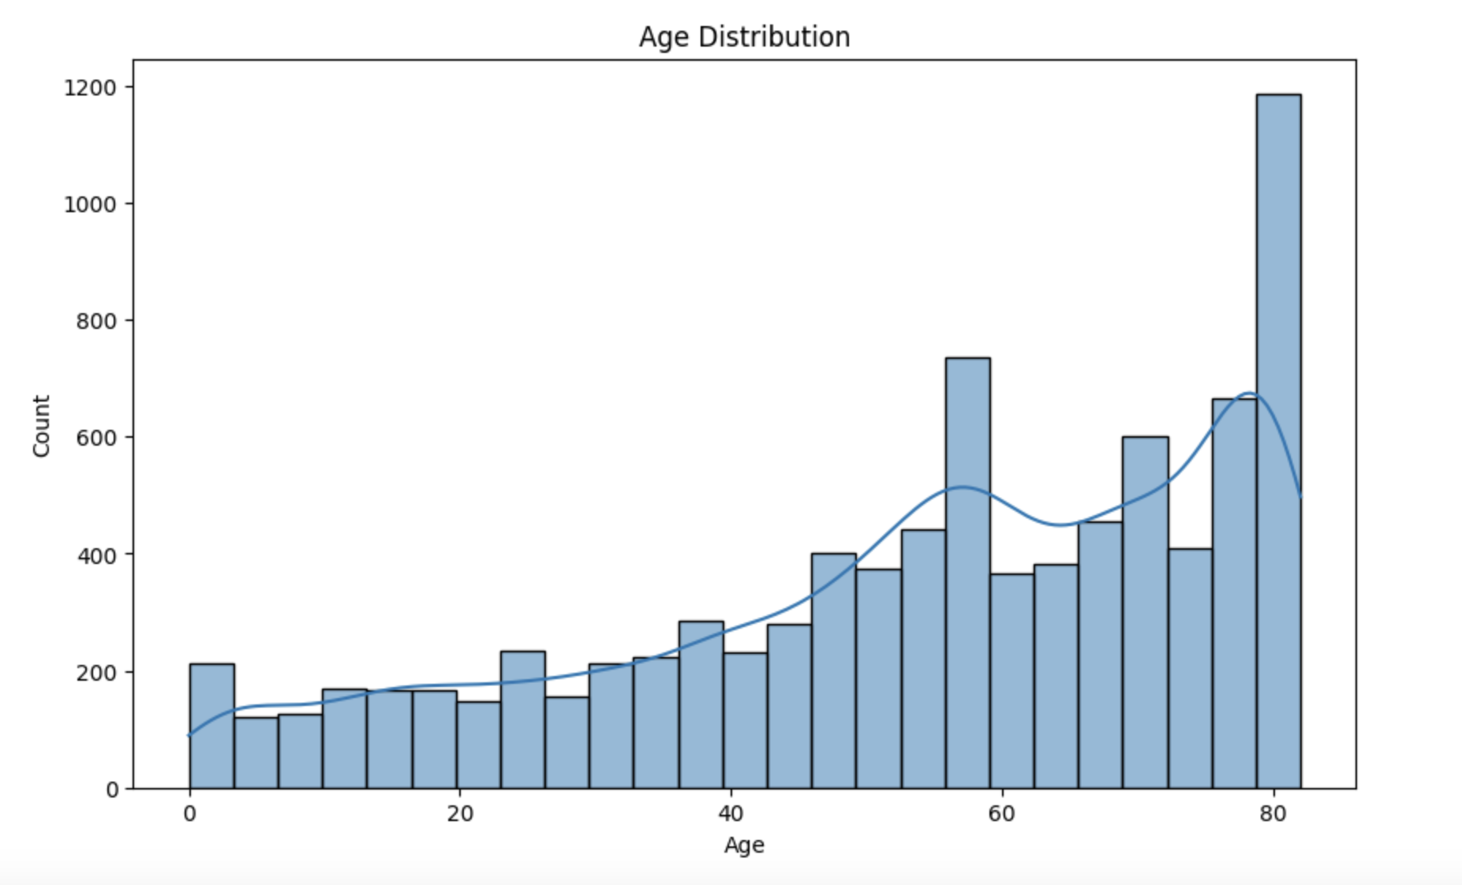

Slide 5
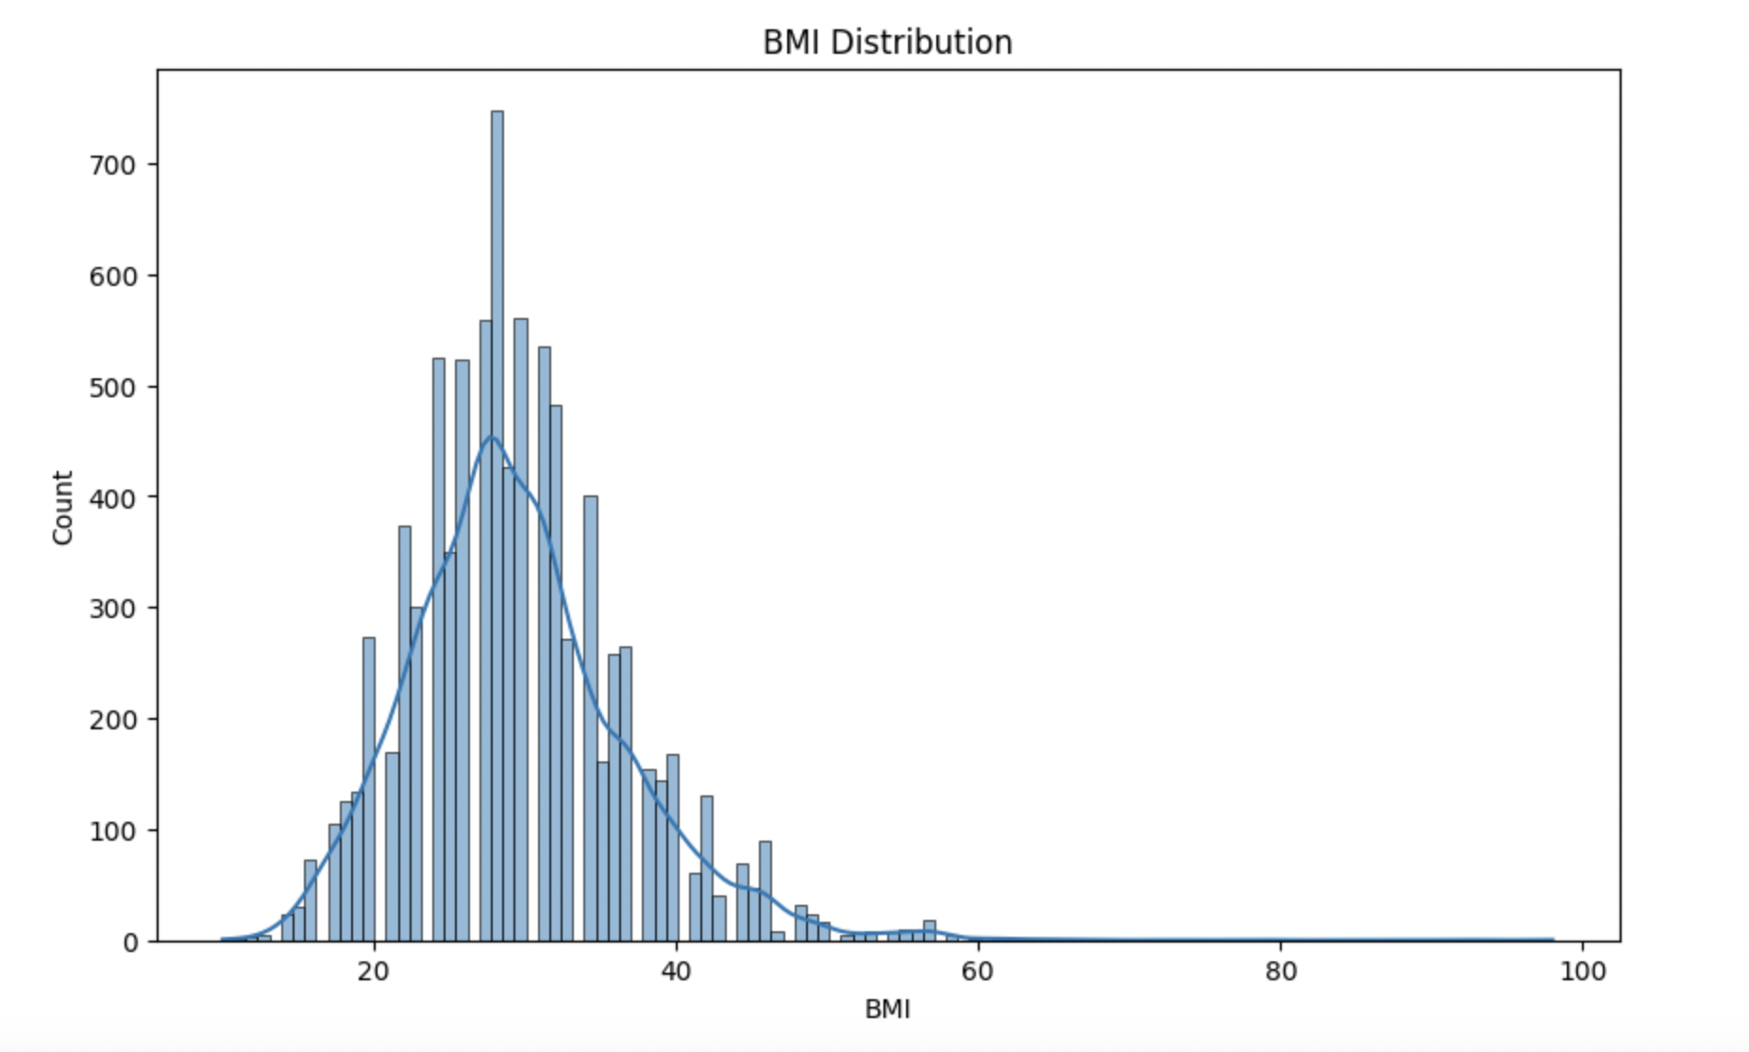

Slide 6
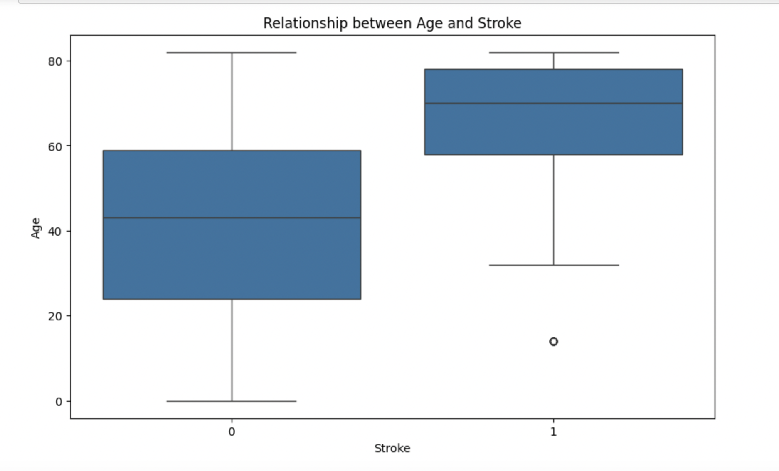

Slide 7
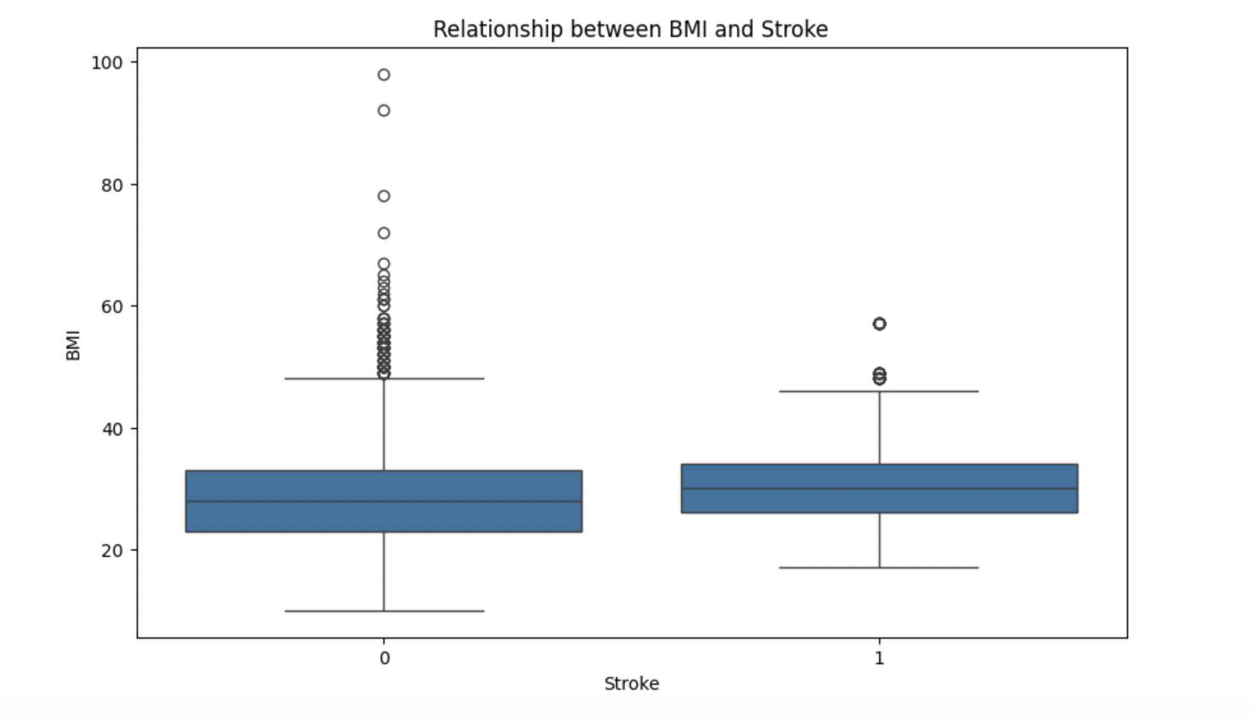

Slide 8
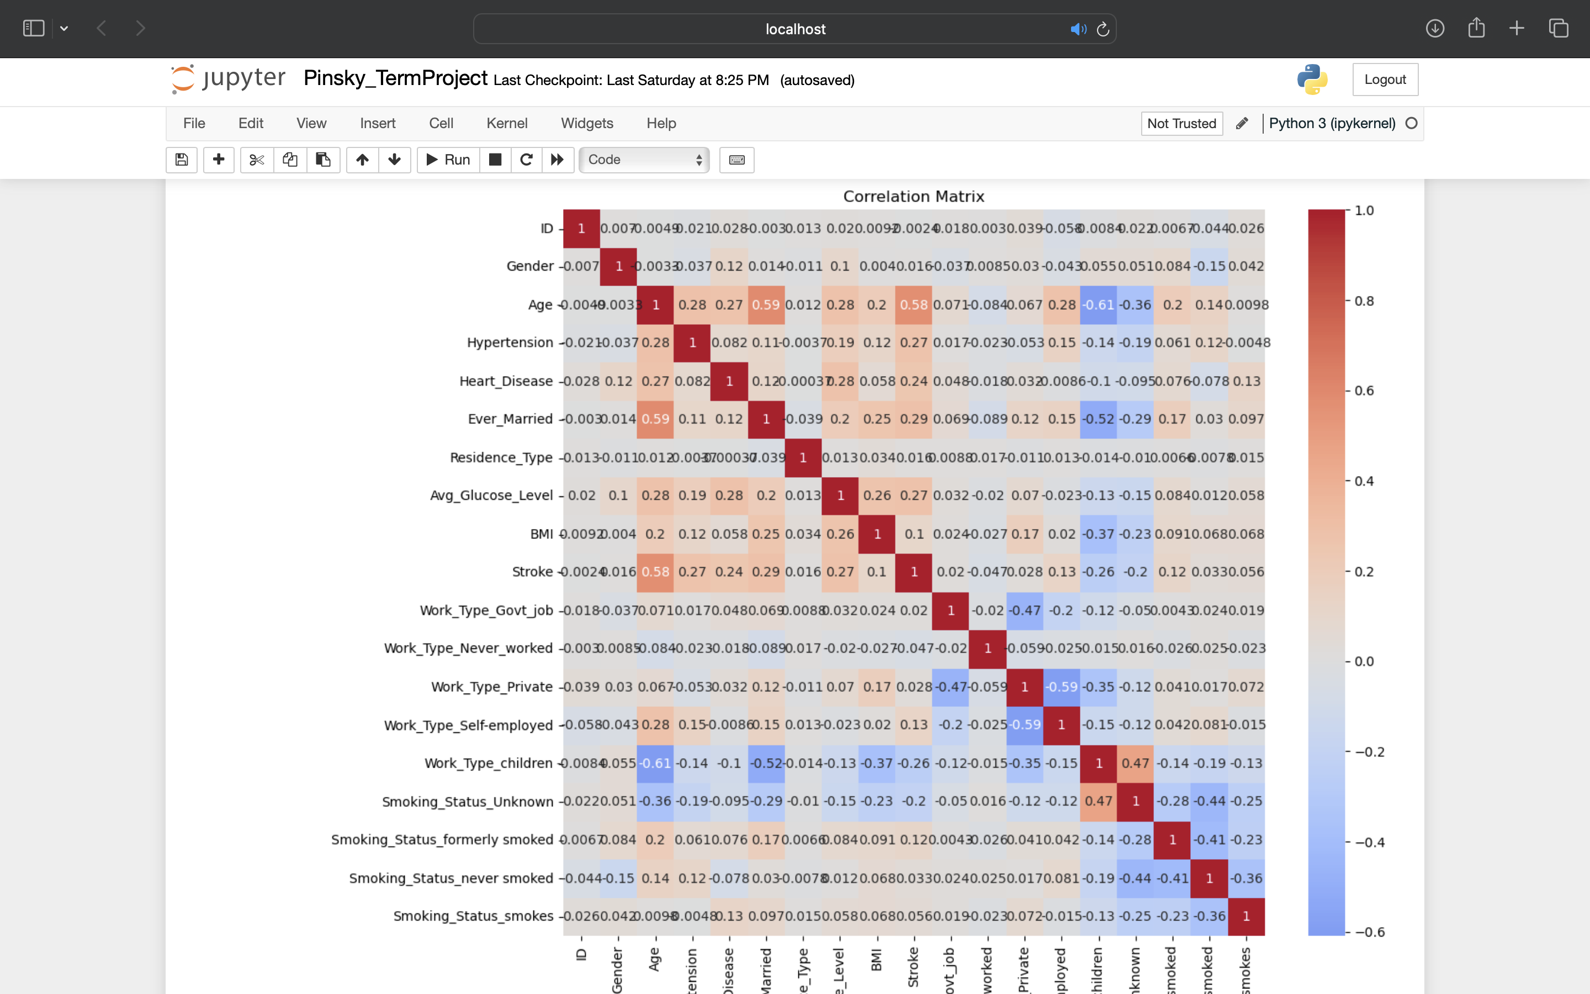

Slide 9
Stroke 1.000000 Age 0.577922 Ever_Married 0.287611 Avg_Glucose_Level 0.271293 Hypertension 0.266370 Heart_Disease 0.242129 Work_Type_Self-employed 0.126320 Smoking_Status_formerly smoked 0.118575 BMI 0.101426 Smoking_Status_smokes 0.055843 Smoking_Status_never smoked 0.033428 Work_Type_Private 0.028022 Work_Type_Govt_job 0.019591 Gender 0.016494 Residence_Type 0.015836 ID -0.002426 Work_Type_Never_worked -0.046605 Smoking_Status_Unknown -0.203317 Work_Type_children -0.255221
Top 10 appropriate correlation analysis

Slide 10
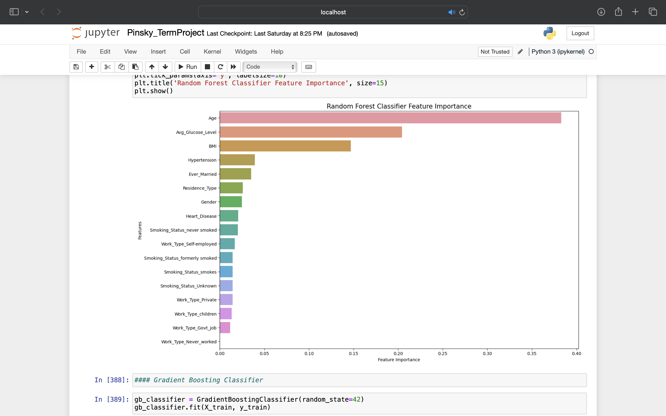

Slide 11
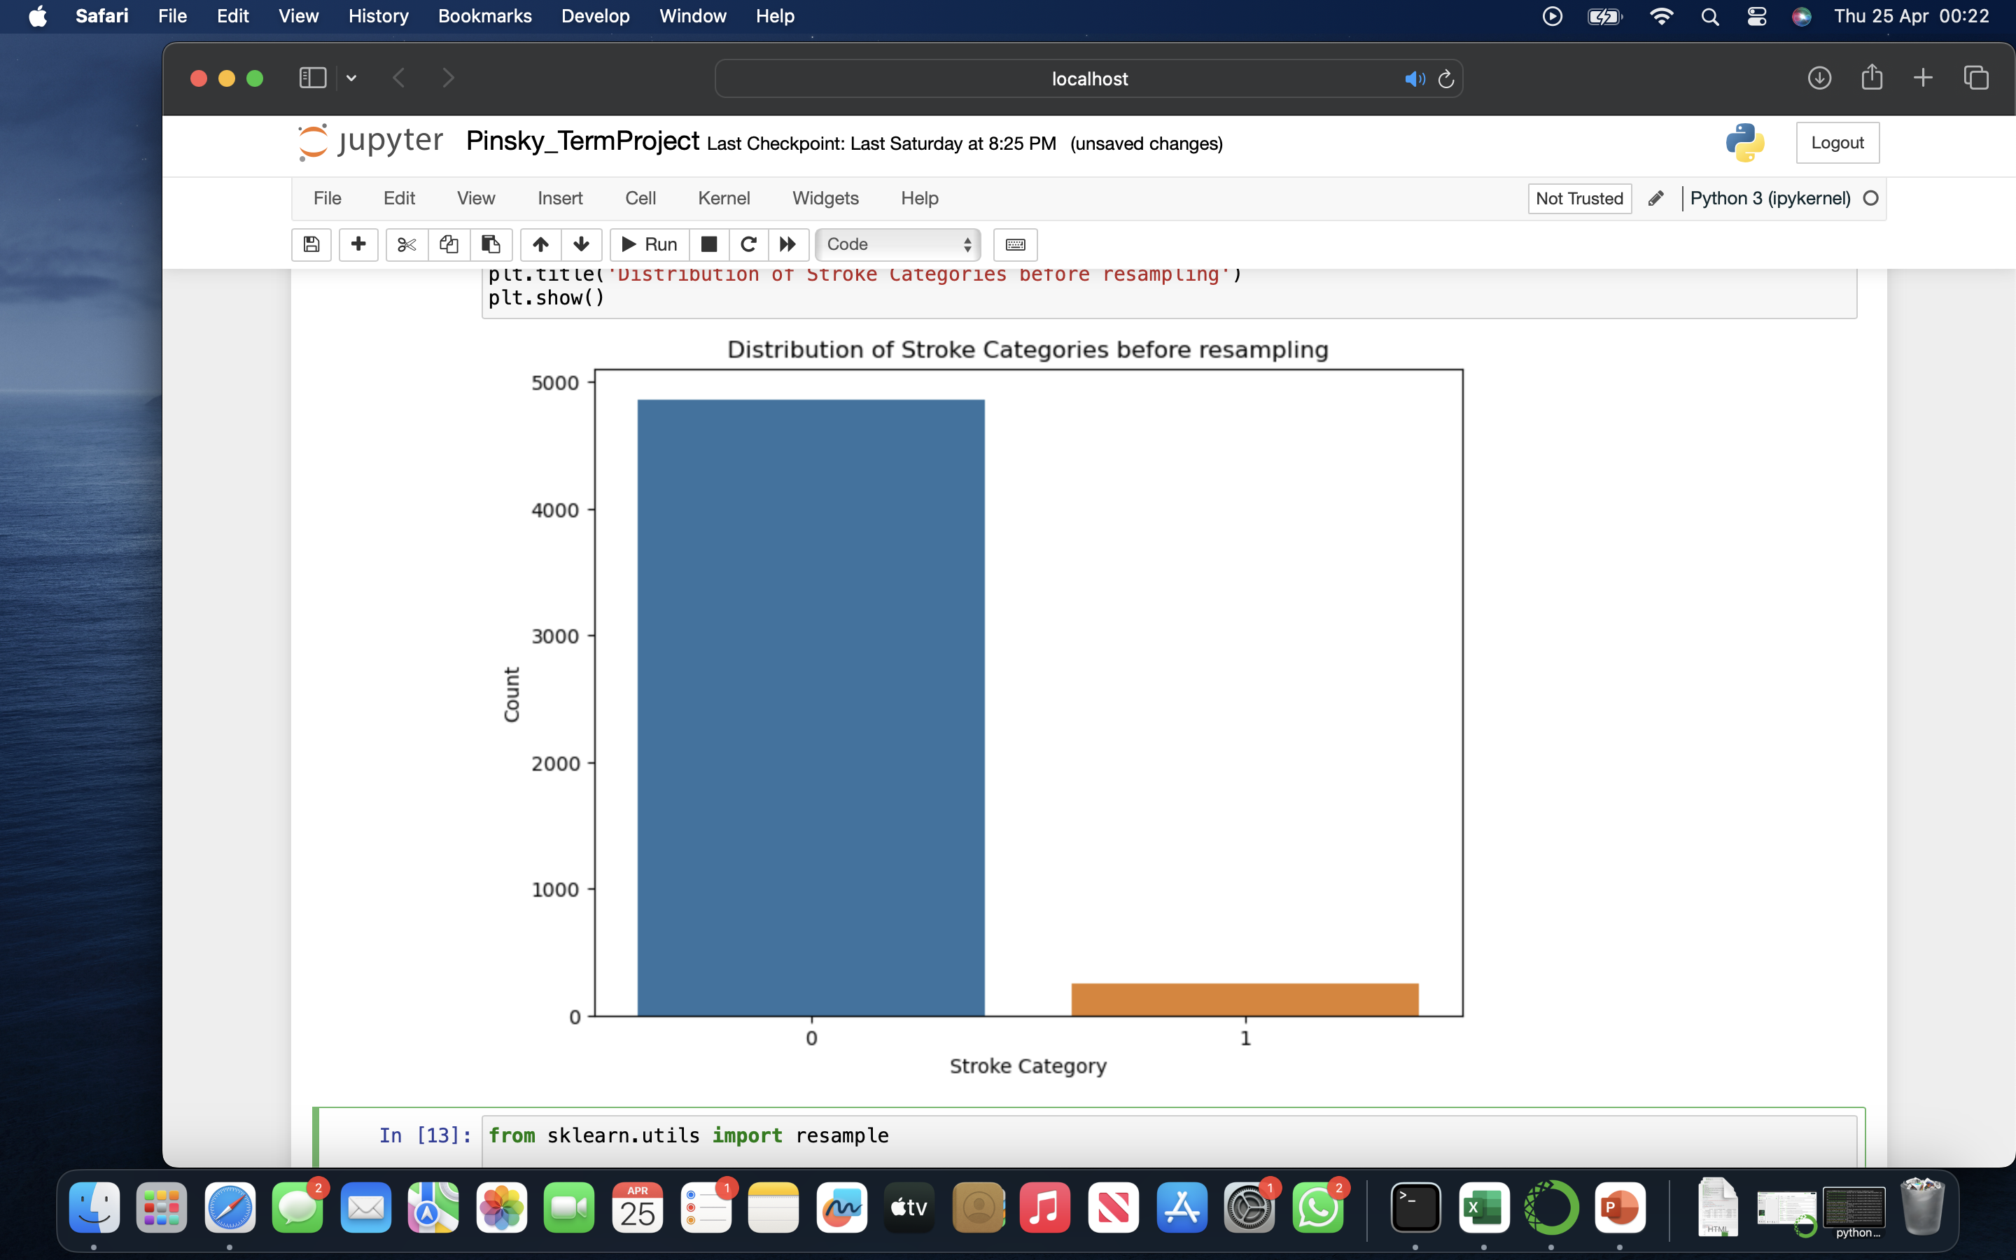
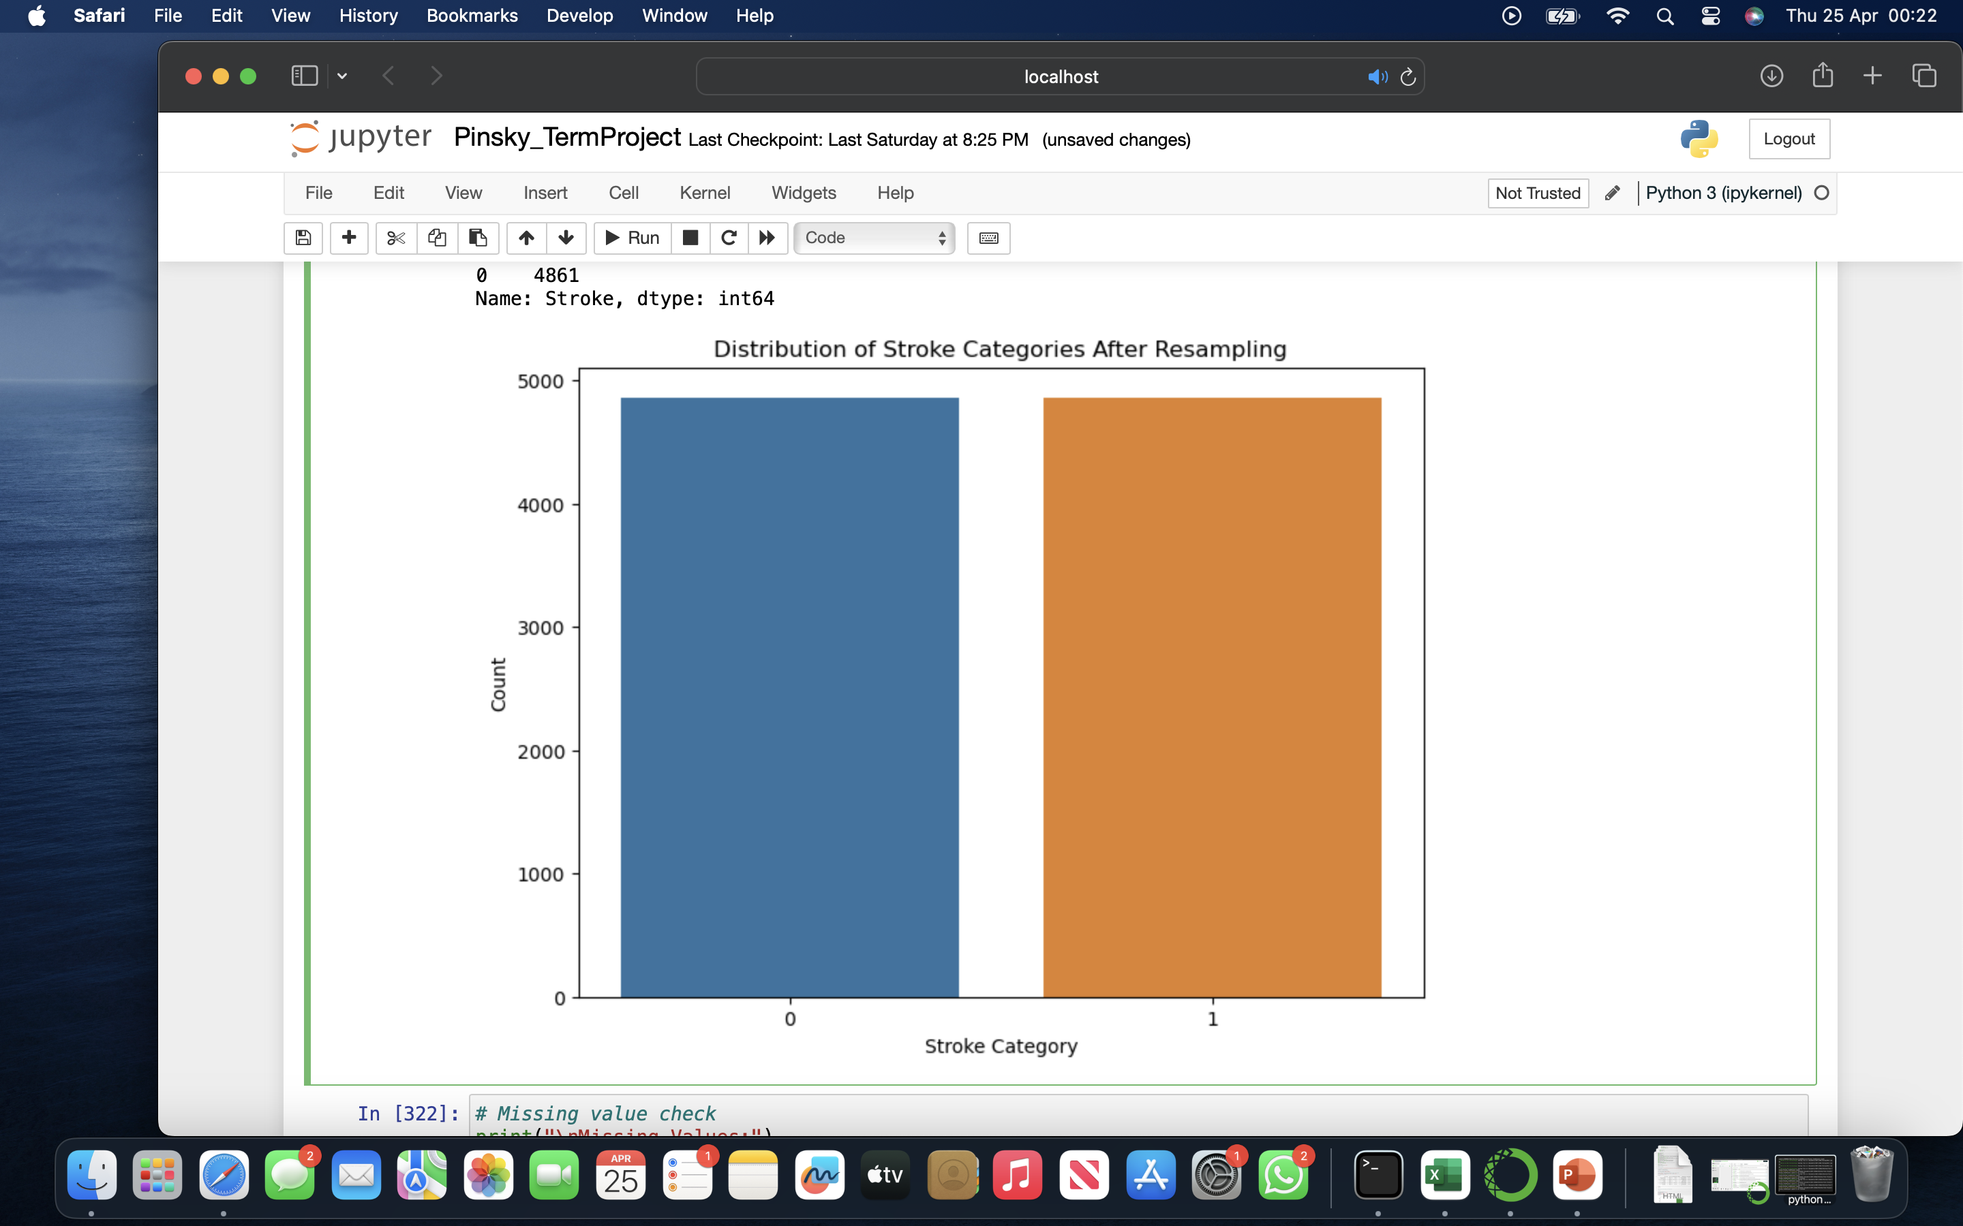
RESAMPLING from sklearn.utils import resample

Slide 12
LOGISTIC REGRESSION
Accuracy: 0.78
Precision: 0.73
Recall: 0.80
F1-score: 0.76
AUC-ROC: 0.85
Confusion Matrix:
[[543 174]
[121 474]]

Slide 13
DECISION TREE CLASSIFIER
Accuracy: 0.96
Precision: 0.93
Recall: 1.0
F1-score: 0.96
AUC-ROC: 0.97
Confusion Matrix:
[[673 44]
[ 0 595]]

Slide 14
RANDOM FOREST CLASSIFIER [BEST MODEL]
Accuracy: 0.99
Precision: 0.98
Recall: 1.0
F1-score: 0.99
AUC-ROC: 1.0
Confusion Matrix:
[[704 13]
[ 0 595]]

Slide 15
GRADIENT BOOSTING CLASSIFIER
Accuracy: 0.85
Precision: 0.79
Recall: 0.91
F1-score: 0.85
AUC-ROC: 0.92
Confusion Matrix:
[[573 144]
[ 50 545]]

Slide 16
SVM
Accuracy:
0.75
Precision: 0.70
Recall: 0.80
F1-score: 0.75
AUC-ROC: 0.84
Confusion Matrix:
[[518 199]
[ 121 474]]

Slide 17

THANK YOU
Presentation by Sneha Agrawal

